Slide 1


BHET
PET
MHET
Terephthalic acid (TPA)
3,4-dihydroxy acid TPA
Protocatechuate
1
$β$-carboxymuconate
2
$γ$-carboxymuconolactone
3
3-oxoadipate-enol-lactone
4
3-oxoadipate
5
3-oxoadipyl-CoA

Slide 2
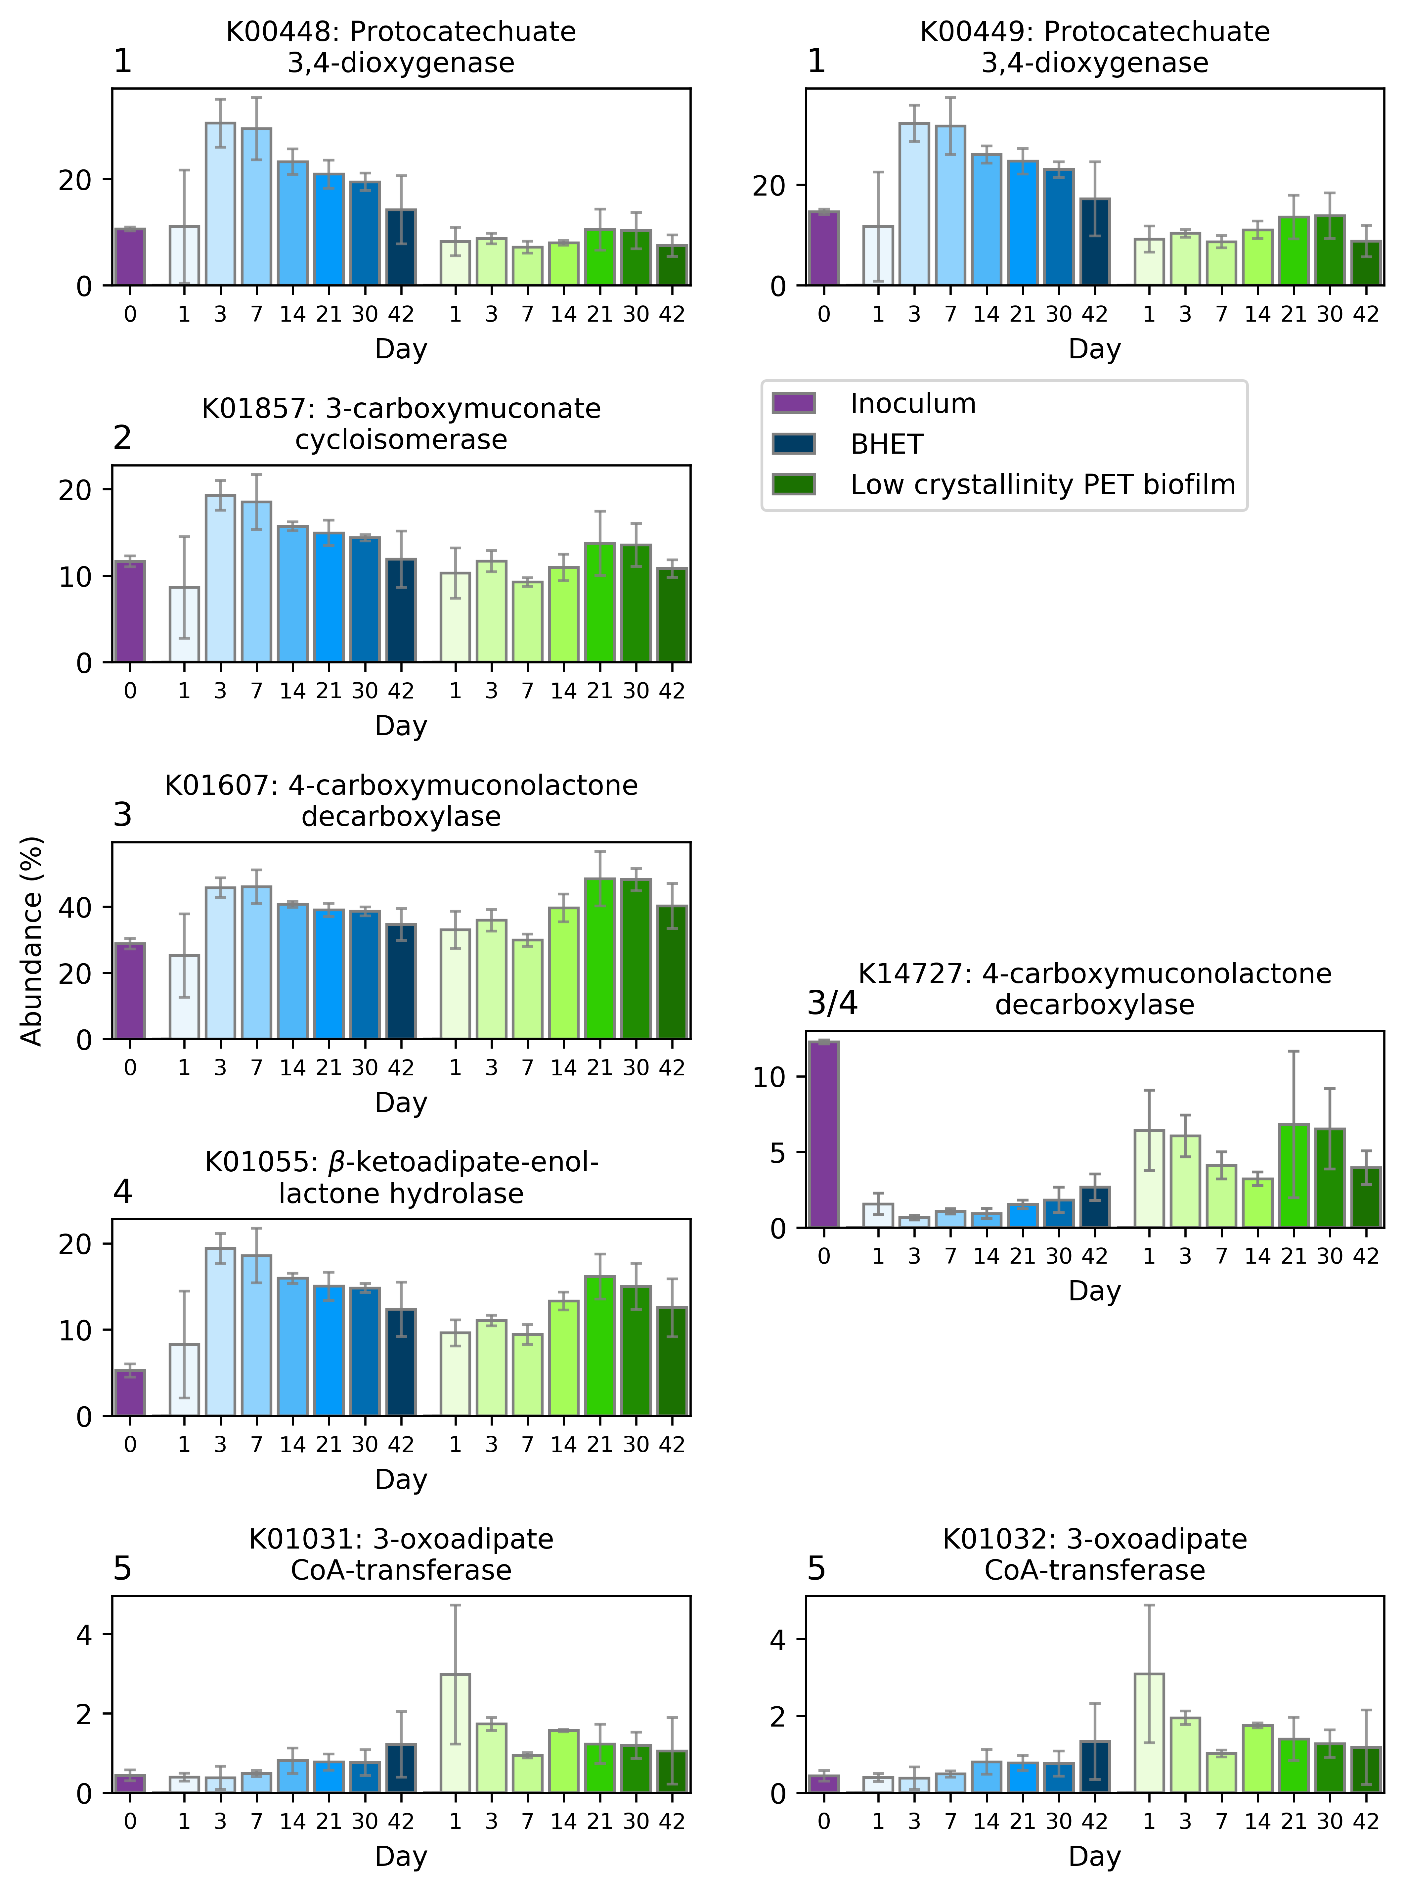
BHET
PET
Protocatechuate
(3,4-dihydroxy benzoate)
MHET
𝛃-carboxy muconate
Terephthalic acid (TPA)
𝛄-carboxy muconolactone
3,4-dihydroxy acid TPA
3-Oxoadipate-enol-lactone -> 3-Oxoadipate
Protocatechuate
1
3-Oxoadipyl-CoA
$β$-carboxymuconate
2
$γ$-carboxymuconolactone
3
3-oxoadipate-enol-lactone
4
3-oxoadipate
5
3-oxoadipyl-CoA

Slide 3
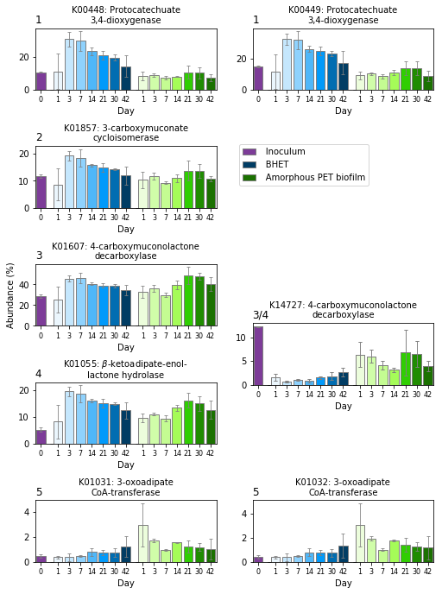


Protocatechuate
(3,4-dihydroxy benzoate)
1
$β$-carboxymuconate
2
$γ$-carboxymuconolactone
3
3-oxoadipate-enol-lactone
4
3-oxoadipate
5
3-oxoadipyl-CoA

